Slide 1
.NET Container Orchestration with Kubernetes, Helm and Draft

Slide 2
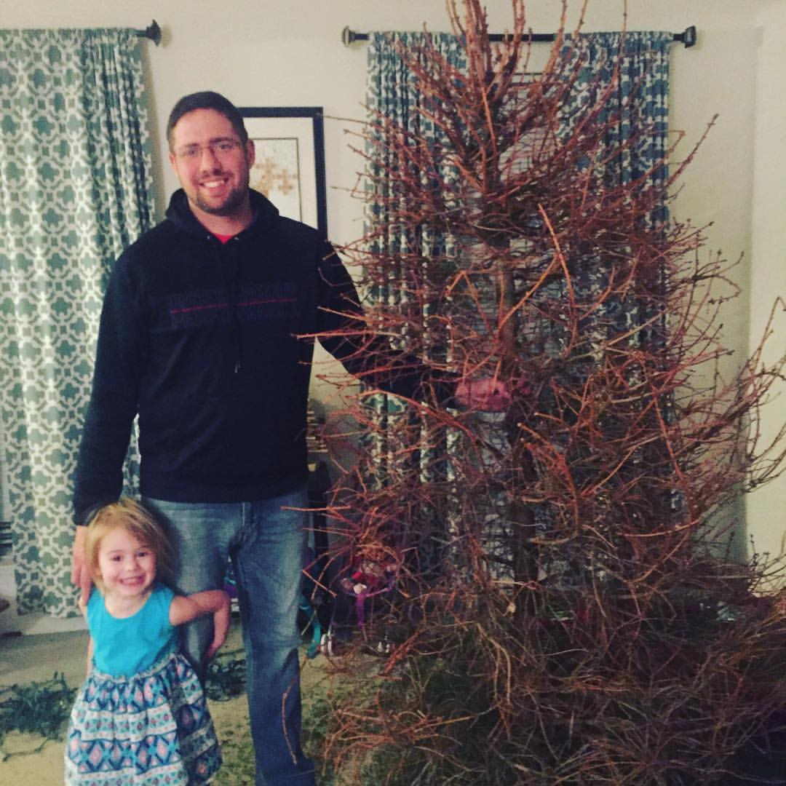

Jason L. van Brackel
Sr. Solutions Architect
@jasonvanbrackel
@k8sPhilly
morehuman.software

Slide 3
More Information on Architecture
DockerCon 16: Windows Server & Docker - The Internals Behind Bringing Docker & Containers to Windows - Black Belt
https://channel9.msdn.com/Blogs/containers/DockerCon-16-Windows-Server-Docker-The-Internals-Behind-Bringing-Docker-Containers-to-Windows

Slide 4
Containers are not VMs
VM
Containers
App A
App A₁
App B
Windows Server Guest OS
Windows Server Guest OS
Windows Server Guest OS
App A
App A₁
App A₂
App A₃
App B
App B₁
Docker
Hypervisor (Type 1)
Server (Host OS)
Server
Server

Slide 5
Containers are not VMs
VMs
Containers
Hardware Virtualization
OS Isolation
Full Copy of the OS
Hypervisor responsible for maintaining isolation
OS Virtualization
Userspace and Namespace Isolation
Enough of the OS for the Application to use
Docker Daemon responsible for maintaining isolation

Slide 6
Containers Don’t Exist
They are an OS abstraction
A combination of
Cgroups
Namespaces
OS constructs

Slide 7
Container Types
Windows Server Containers
Hyper-V Containers (Default)

Slide 8
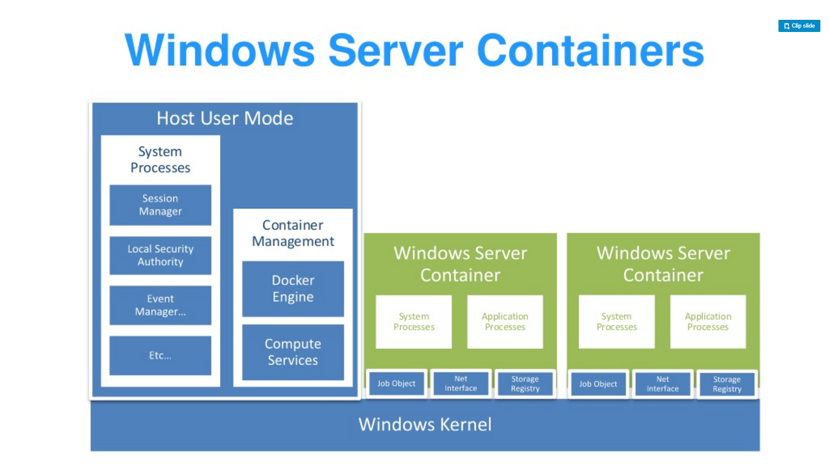
Source: “DockerCon 16: Windows Server & Docker - The Internals Behind Bringing Docker & Containers to Windows - Black Belt”

Slide 9
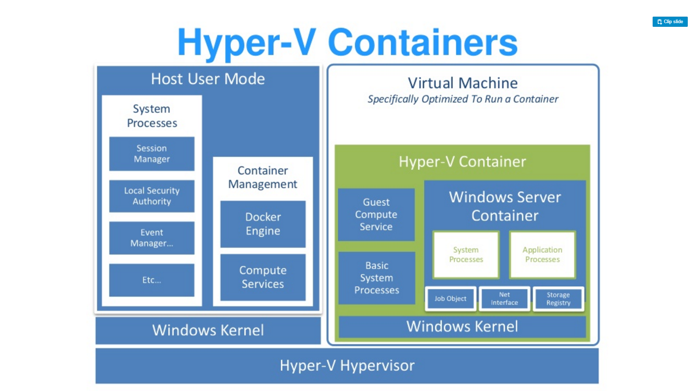
Source: “DockerCon 16: Windows Server & Docker - The Internals Behind Bringing Docker & Containers to Windows - Black Belt”

Slide 10
Getting Started With Docker
On Windows 10
https://docs.microsoft.com/en-us/virtualization/windowscontainers/quick-start/quick-start-windows-10
On Windows Server 2016
https://docs.microsoft.com/en-us/virtualization/windowscontainers/quick-start/quick-start-windows-server

Slide 11
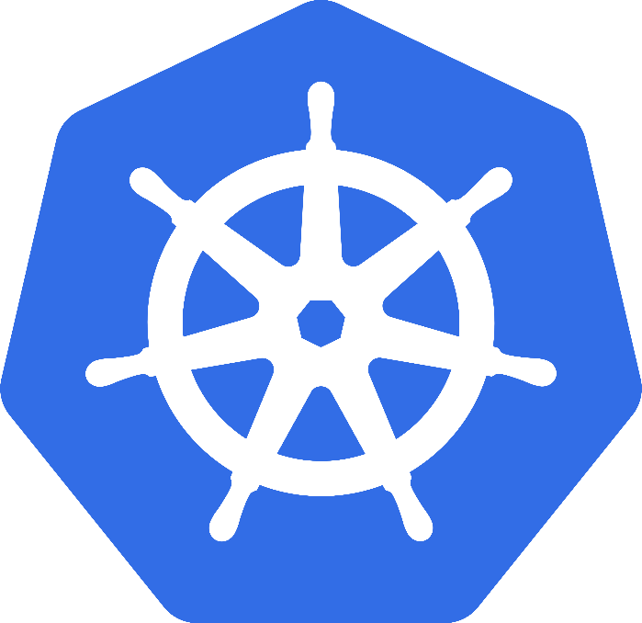
Kubernetes
Greek for “Helmsman”; also the root of the word “Governor”
Google’s 3rd Container Platform (Borg, Omega)
Set of compossable building blocks
Container orchestrator
Runs Docker / Rkt / Linux containers / Windows Containers
Supports multiple cloud and bare-metal environments
Built on lessons learned from Borg and Omega
Written in Go
Manage applications, not machines
Kubernetes SIG-Windows
Notes:
Omega: Raw State Omega: Multiple Schedulers, Compossable building blocks

Slide 12
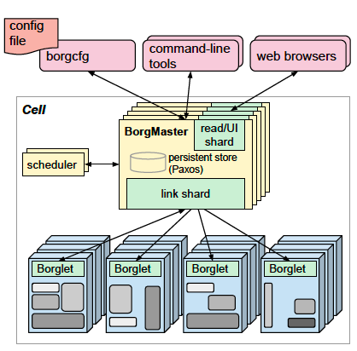
Kubernetes Lineage Google Borg
Runs hundreds of thousands of jobs..
..for many thousands of different applications (YouTube, Search Index, Maps, etc.)..
..across a number of clusters (hundreds)..
..each with up to tens of thousands of machines..
Borg currently manages many millions of physical servers hosting billions of containers!
In production since 2003!
Offers a declarative job specification language, name service integration, real-time job monitoring, and tools to analyze and simulate system behavior.
Source: Large-scale cluster management at Google with Borg

Slide 13
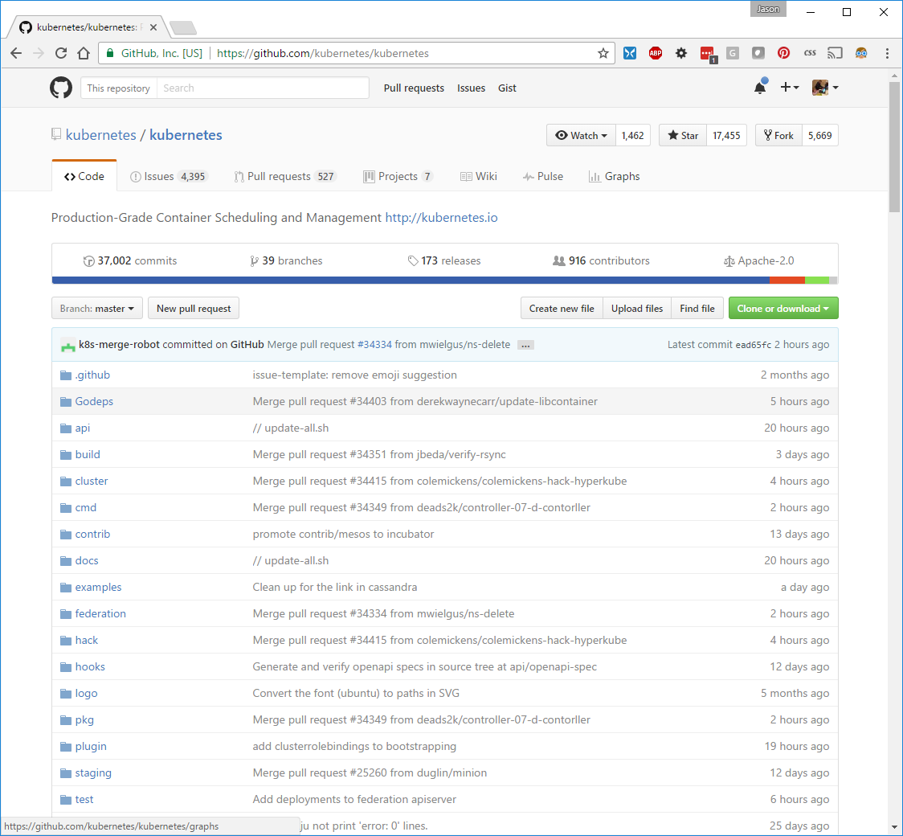

Slide 14
Key Concepts
Container: An application package (Docker / Rocket)
Pod: A small group of tightly coupled Containers
Controller: A loop that drives current state towards desired state
Service: A set of running pods that work together
Labels: Identifying metadata attached to other objects
Selector: A query against labels, producing a set result
Secret: Hide stuff

Slide 15
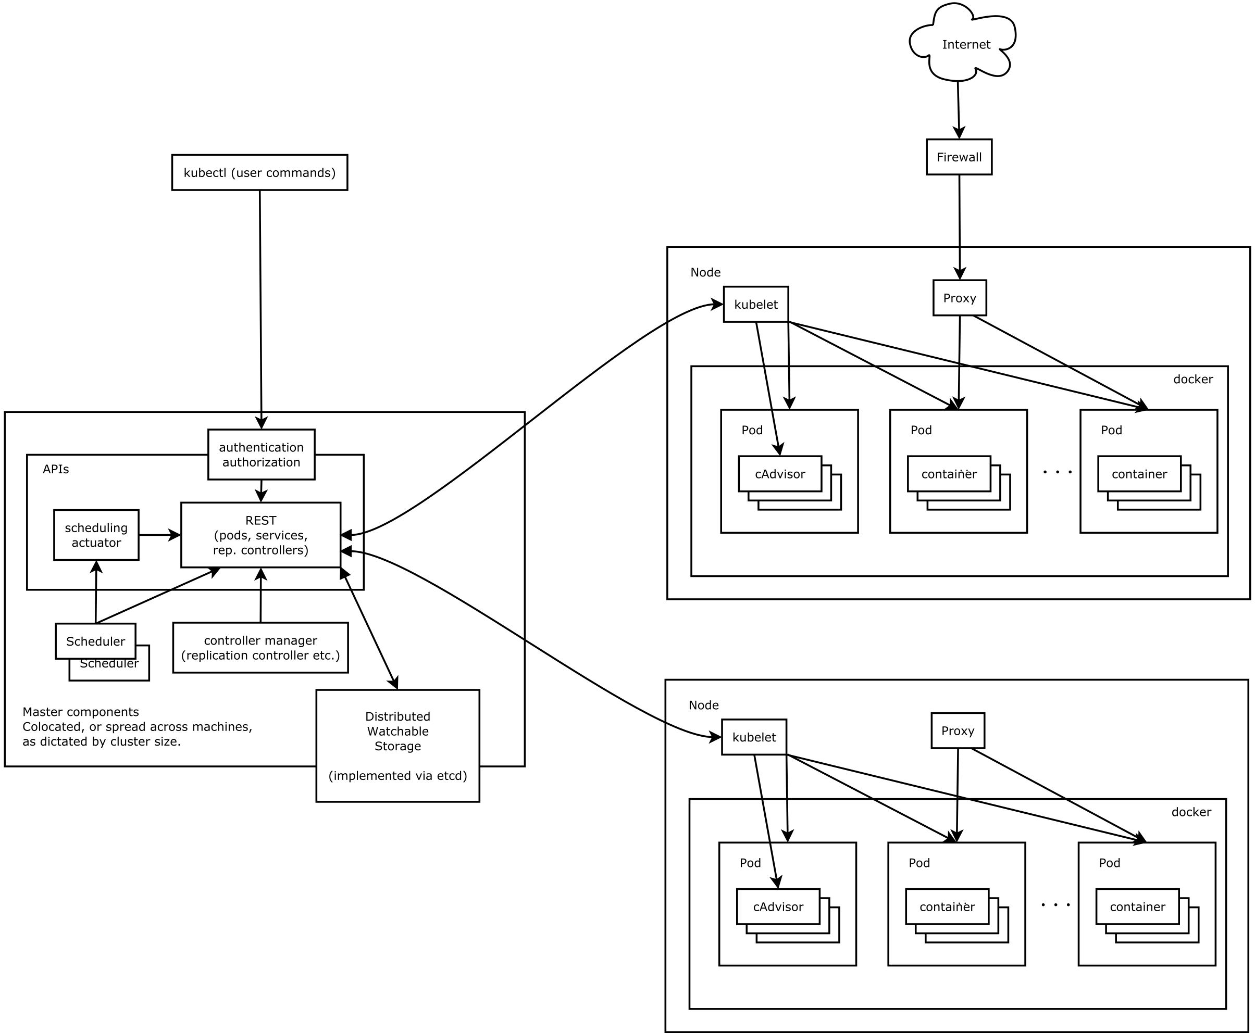
Architecture
Source: https://github.com/kubernetes/kubernetes/blob/release-1.4/docs/design/architecture.md

Slide 16
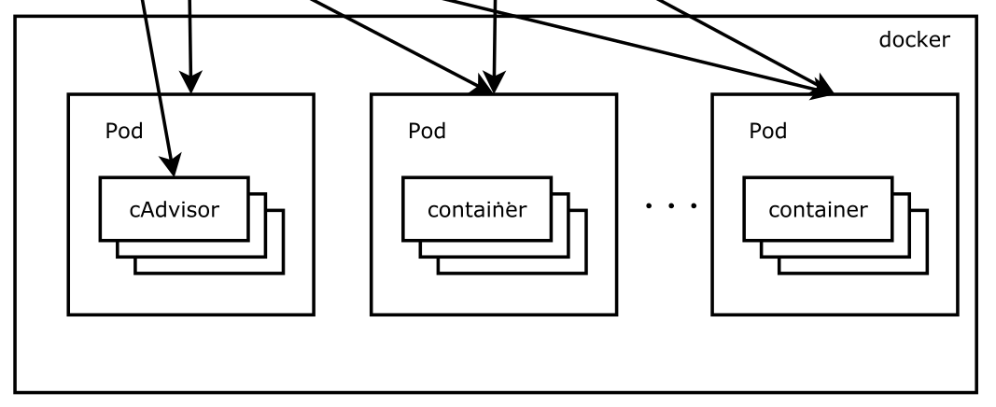
Pods
Source: https://github.com/kubernetes/kubernetes/blob/release-1.4/docs/design/architecture.md

Slide 17
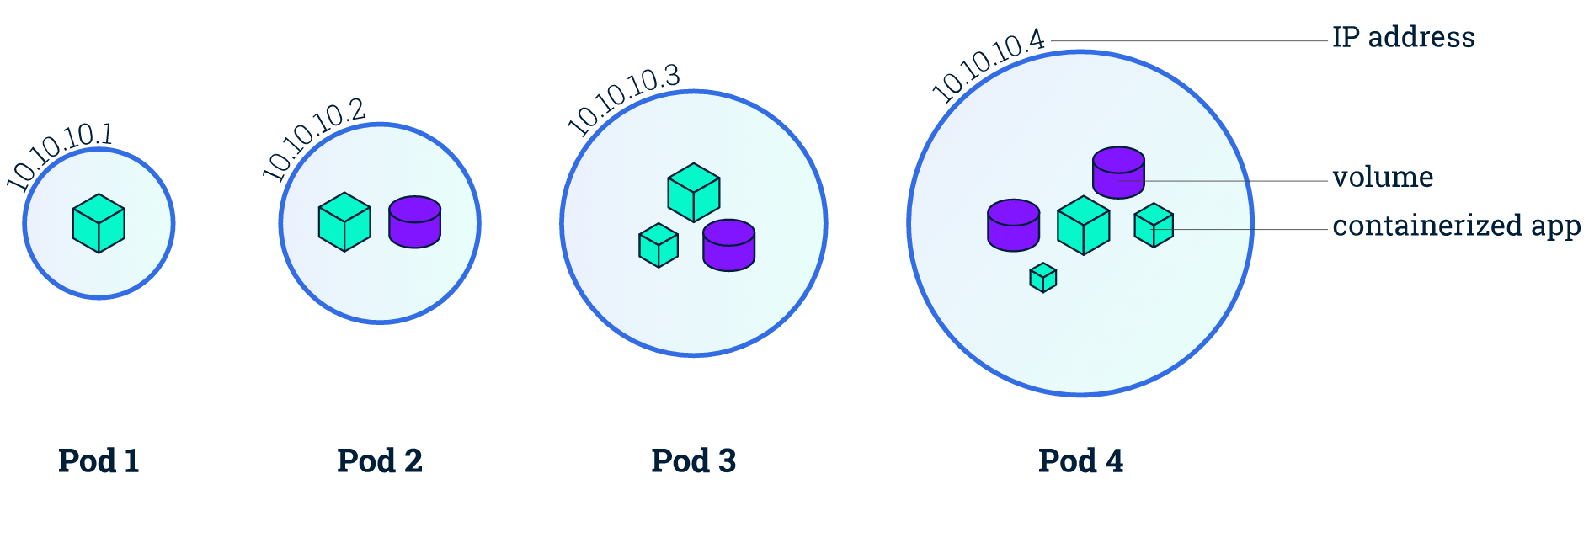
Pods
Small group of containers & volumes
Tightly coupled
Always on the same node
Atomic unit of cluster scheduling & placement
Shared namespace, IP and localhost
Ephemeral

Slide 18
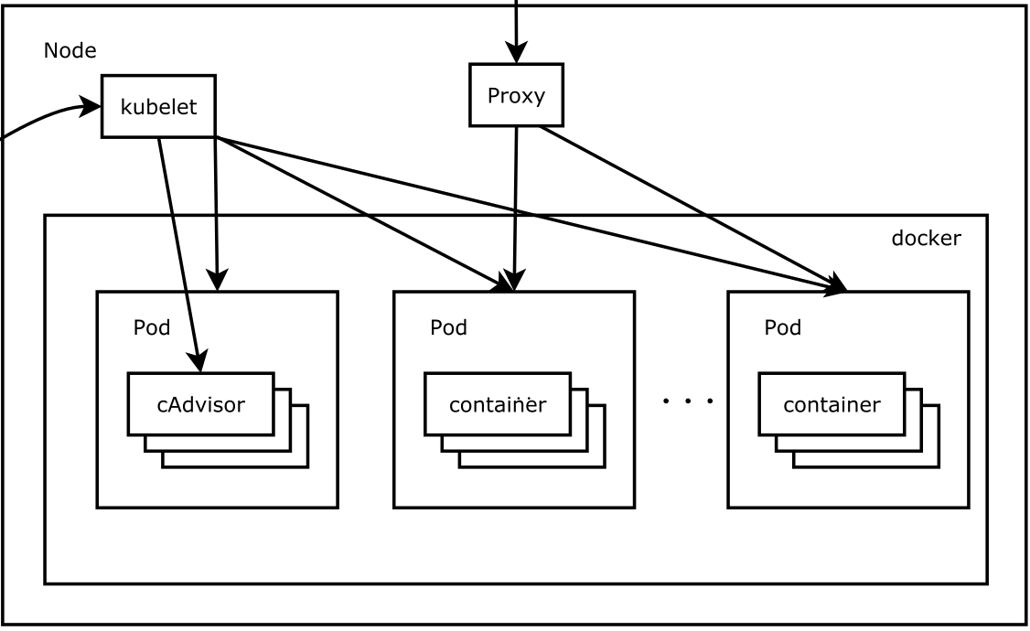
Nodes
Source: https://github.com/kubernetes/kubernetes/blob/release-1.4/docs/design/architecture.md

Slide 19
Nodes
Worker Machine
Physical or Virtual
Each node runs kubelet
Manages pods, containers, images and volumes
Each node runs kube-proxy
Simple network proxy and load balancer supporting services

Slide 20
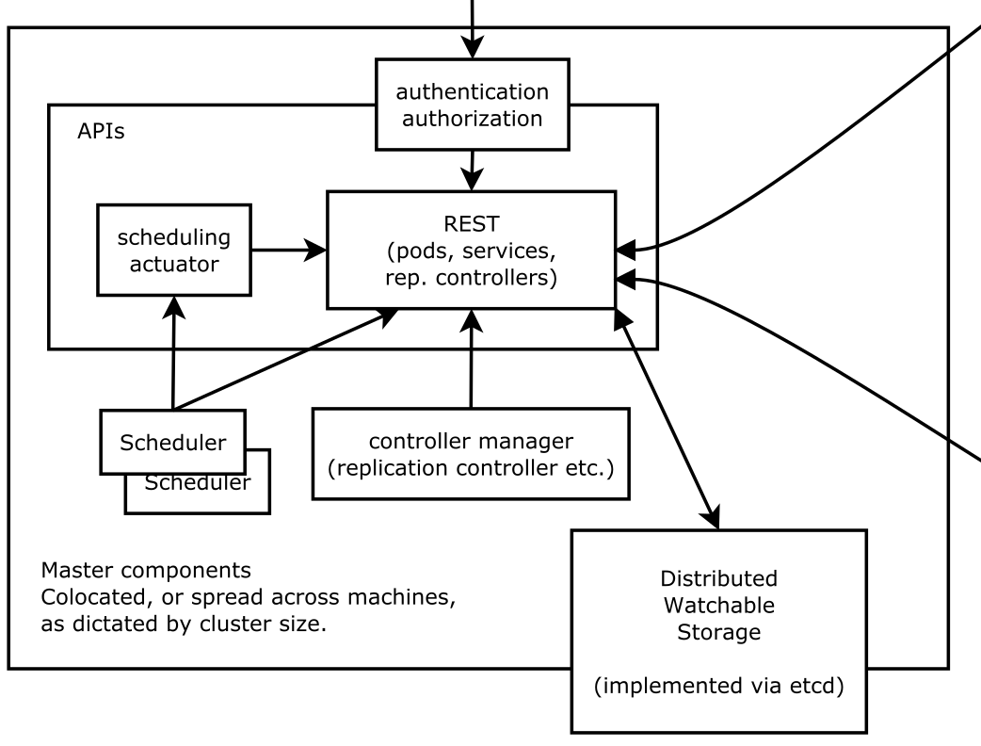
Master Node
Source: https://github.com/kubernetes/kubernetes/blob/release-1.4/docs/design/architecture.md

Slide 21
Master Node
Controls the cluster
Schedules all pods within the cluster
Very modular
Provides control and introspection of the cluster through REST API
Permanent master state managed by etcd
All other cluster-level functions are currently performed by the Controller Manager.
Endpoints objects are created and updated by the endpoints controller
Nodes are discovered, managed, and monitored by the node controller.
Replication Controller

Slide 22
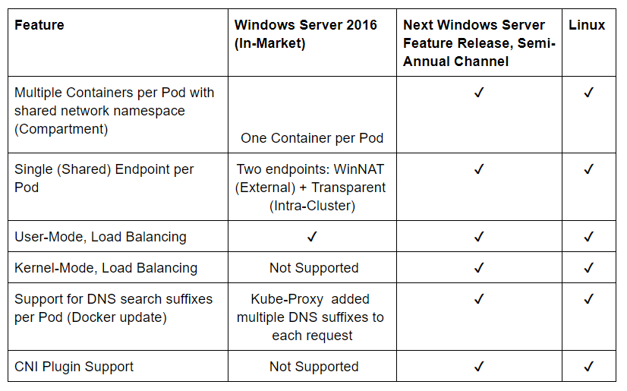
Current State vs Past State
http://blog.kubernetes.io/2017/09/windows-networking-at-parity-with-linux.html

Slide 23

What is Helm?
Helm helps you manage Kuberentes-based applications via charts
Features
Install
Upgrade
Rollback
Delete

Slide 24
What is Helm?
Helm uses Tiller to manange Kubernetes application via Charts
Charts include
Kubernetes API Definiton templates for the application
Configurable Values
Chart metadata for publishing
https://helm.sh

Slide 25

What is Draft?
Draft extends Helm to help you bootstrap configuration for Kubernetes based applications.
Features
Create
Upgrade
Connect

Slide 26
What is Draft?
Draft uses Packs to author charts based on code scanning heuristics.
Draft supports
Java
Node
DotNet (Core)
Go
And more

Slide 27
Demo Time
https://morehuman.software
https://github.com/JasonvanBrackel/dotnet-containerization-with-k8s-helm-draft

